Slide 1
Agile Development Methodologies

Slide 2
It is a method under which requirements and solutions evolved through the collaborative effort of cross-functional teams(group of people with different functional expertise working toward a common goal). It incorporate adaptive planning, evolutionary development, early delivery, and continuous improvement, and it encourages rapid and flexible response to change.

Slide 3
Agile is a software development methodology to build a software incrementally using short iterations of 1 to 4 weeks so that the development is aligned with the changing business needs.
Instead of a single-pass development of 6 to 18 months where all the requirements and risks are predicted upfront, Agile adopts a process of frequent feedback where a workable product is delivered after 1 to 4 week iteration.

Slide 4
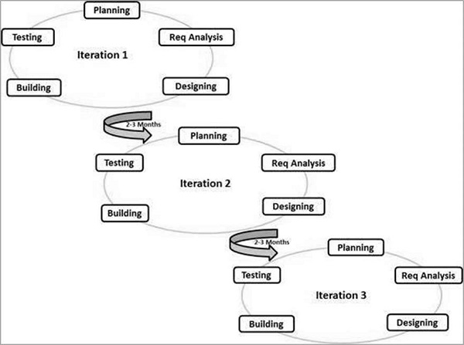
Agile

Slide 5
Agile is based on the adaptive software development methods.
there is no detailed planning and there is clarity on future tasks only in respect of what features need to be developed.
Customer Interaction is the backbone of this Agile methodology, and open communication with minimum documentation are the typical features of Agile development environment.

Slide 6
Methods of Agile Development
Scrum
Extreme Programming
Aspect Oriented Programming
Adaptive Software development
Rapid Application Development
Software Coloning

Slide 7
Scrum
It is an implementation of Agile.
Scrum is an efficient framework within which you can develop software with teamwork.
It works in incremental style i.e one requirement is taken,designed,coded and reviewed. This is called one sprint. It develops the full software in several sprints

Slide 8
Three keyroles of scrum team
Product Owner:The Product Owner is responsible for maximizing the value of the product and the work of the Team. The Product Owner is the sole person responsible for managing the Product Backlog.
Scrum Master:The ScrumMaster is the keeper of the scrum process. responsible for-
  making the process run smoothly
  removing obstacles that impact productivity
  organizing and facilitating the critical meetings
Team:The Team is self-organizing and cross-functional. That means the team comprises of analysts, designers, developers, testers, etc. as appropriate and as relevant to the project.

Slide 9
Scrum is the most popular agile framework, which concentrates particularly on how to manage tasks within a team-based development environment. Scrum uses iterative and incremental development model, with shorter duration of iterations. Scrum is relatively simple to implement and focuses on quick and frequent deliveries.

Slide 10
Extreme Programming
Extreme Programming technique is very helpful when there is constantly changing demands or requirements from the customers or when they are not sure about the functionality of the system. It advocates frequent "releases" of the product in short development cycles, which inherently improves the productivity of the system and also introduces a checkpoint where any customer requirements can be easily implemented. The XP develops software keeping customer in the target.

Slide 11
RAD
RAD approaches to software development put less emphasis on planning and more emphasis on process.
The RAD (Rapid Application Development) model is based on prototyping and iterative development with no specific planning involved. The process of writing the software itself involves the planning required for developing the product.

Slide 12
the functional modules are developed in parallel as prototypes and are integrated to make the complete product for faster product delivery. Since there is no detailed preplanning, it makes it easier to incorporate the changes within the development process.

Slide 13
Adaptive Software Development
Adaptive Software Development is a software development process that replaces the traditional waterfall cycle with a repeating series of speculate, collaborate, and learn cycles.
Adaptive Software Development process model has divided into 3 steps:

Slide 14
ASD is made of three steps (speculate, collaborate, and learn) . So , here those steps described briefly:
Speculate --> Initiation and Planning
Collaborate --> Concurrent feature development
Learn --> Quality Review

Slide 15
There is never a period where the software is finished; there are just stable periods between new releases. Adaptive software development grew out of the rapid application development method. These two methods are similar in structure, but rapid application development allows for a time when the project is finished, while adaptive software development doesn't.

Slide 16
Aspect Oriented Programming
aspect-oriented programming (AOP) is a programming paradigm that aims to increase modularity by allowing the separation of cross-cutting concerns. It does so by adding additional behaviour to existing code without modifying the code itself.

